Slide 1
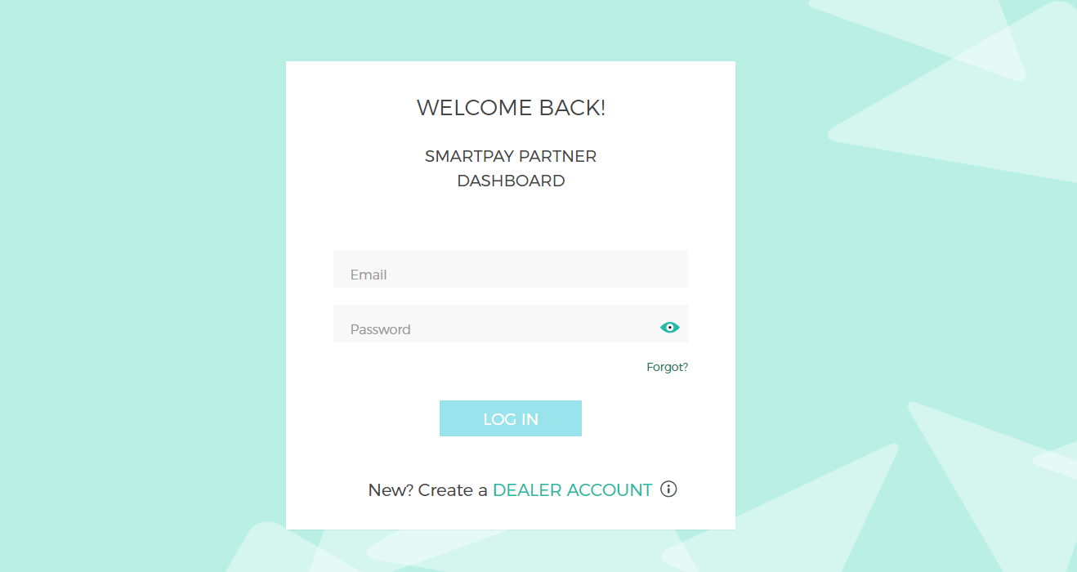
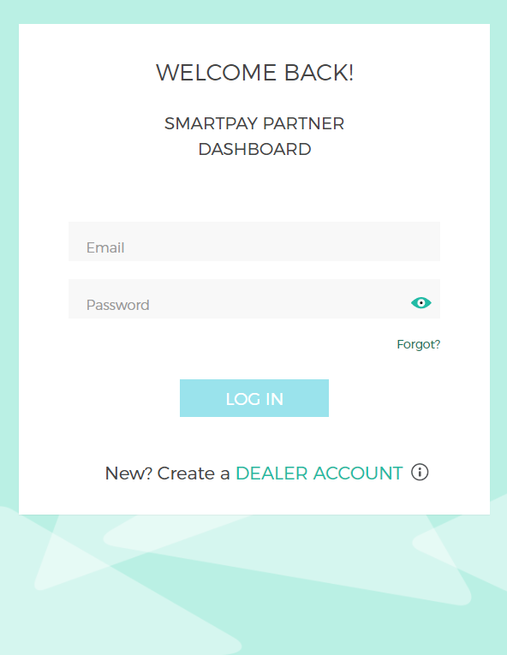
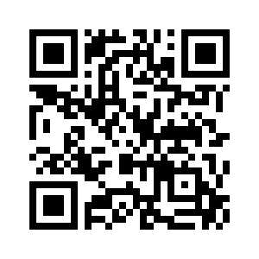
To complete the SmartPay enrollment process you will need:
Once you have completed the SmartPay application please email the required documents to onboarding@smartPaylease.com
Enroll With SmartPay
Go To
https://sp.lease/partner/tracfonestore
Requirements
Business Information
Business License(s)
Bank Account | Voided Check
Photo ID
Scan the code below to enroll in SmartPay today.
SCAN THE CODE
Drive Device and Accessory Sales with SmartPay.
SmartPay Partner Dashboard
Access comprehensive store reporting, individual lease performance numbers and follow up with customers within the 30 day approval window.
Resources
https://sp.lease/partner/tracfonestore
Dealer Support
Phone | (855) 432-2540
Email | dealer@smartpaylease.com
-Or- reach out to your field sales manager
No Credit Required | Simple Application | Monthly Payments | No Long-Term Commitment

Slide 2
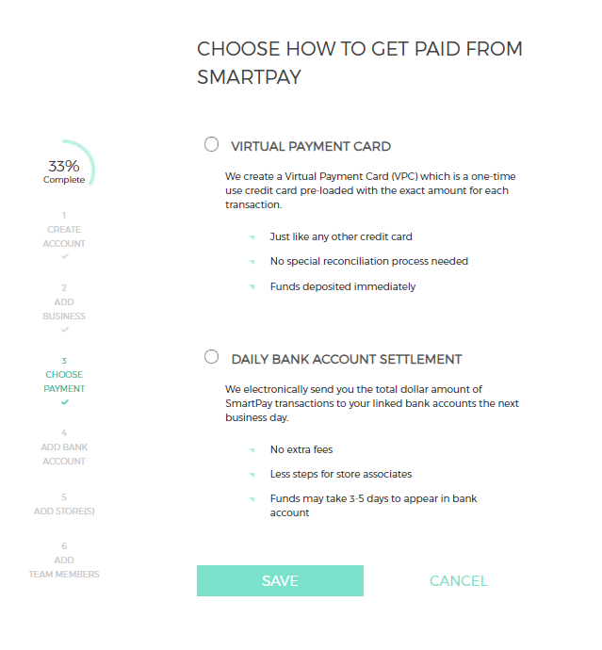
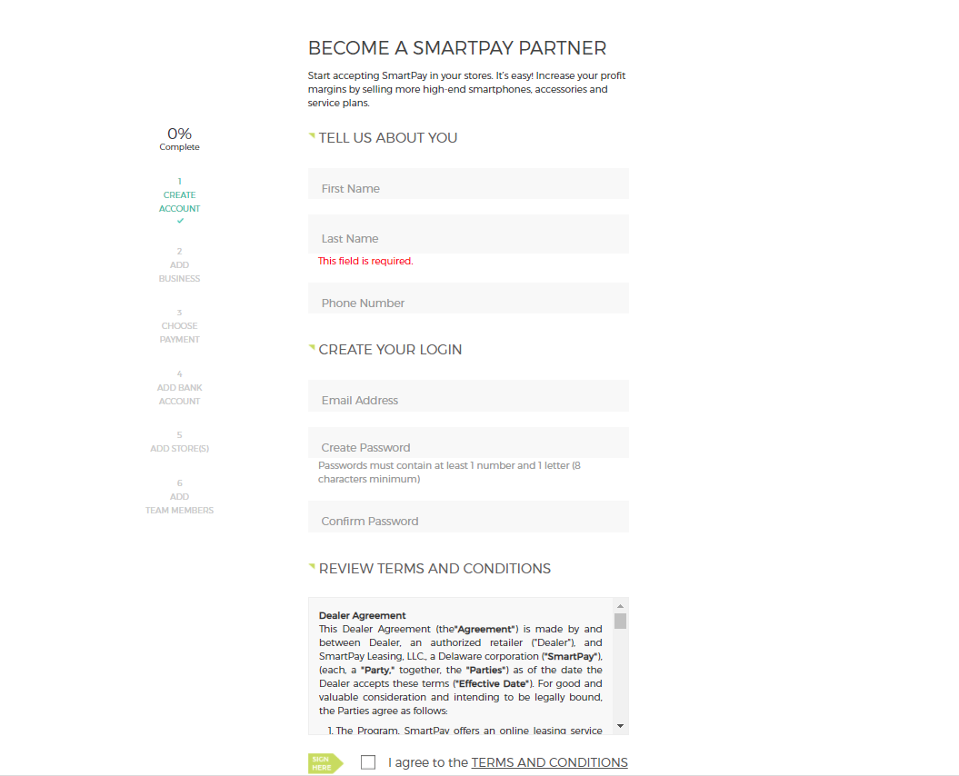
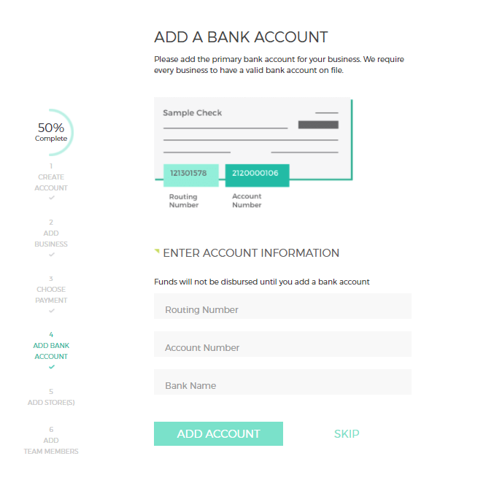
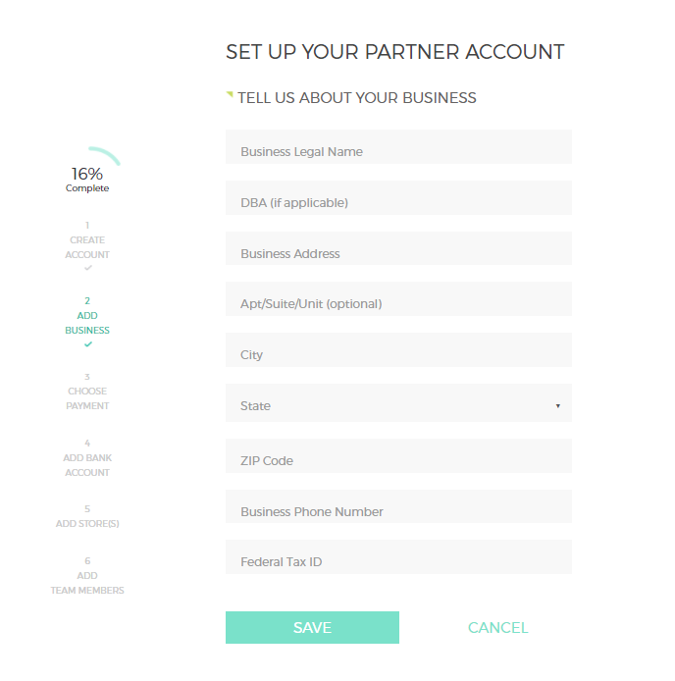
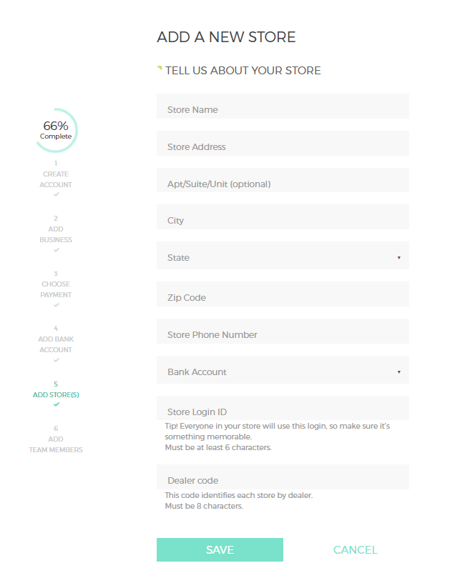
SmartPay Enrollment Process
FAQ
1
How do I access the SmartPay Dealer Portal?
Go to https://sp.lease/partner/tracfonestore
Enter the email address you used to register with SmartPay
Enter the password you used on the SmartPay Dealer Portal
How do I change my SmartPay Login ID in the portal?
Login to dealer portal, click on business or selected store info, then edit accordingly.
I cannot log in to the SmartPay Dealer Portal, what should I Do?
Click on forgot password, or contact dealer support. If contacting dealer support please have store ID available to assist us in locating your account.
What if I do not know my email and password for the SmartPay Dealer Portal?
Contact dealer support. When contacting dealer support please have store ID available to assist us in locating your account.
Login | Create New Account
Existing dealers can login to the dashboard or if you are new to SmartPay select:
CREATE A DEALER ACCOUNT
4
Confirm Payment Method
ACH | Bank Account
Electronically transfer funds to your bank account the next business day. Funds settle in 3-5 business days.
2
Enroll In SmartPay
It only takes a few minutes to enroll. Provide basic dealer information, create a login, review the terms & conditions and sign the agreement.
5
Add a Bank Account
Add a primary bank account for your business. This is how SmartPay will transfer funds for each lease transaction. You can add multiple bank accounts if needed.
3
Business Information
Tell us a little bit about you. Provide us with your business’s legal name, DBA, address, phone number and federal tax ID.
6
Add additional Locations
You update your account with store information for additional locations and add store employees.
Each new account is reviewed and approved. Please allow 2-3 business days for your account to be active

